Slide 1
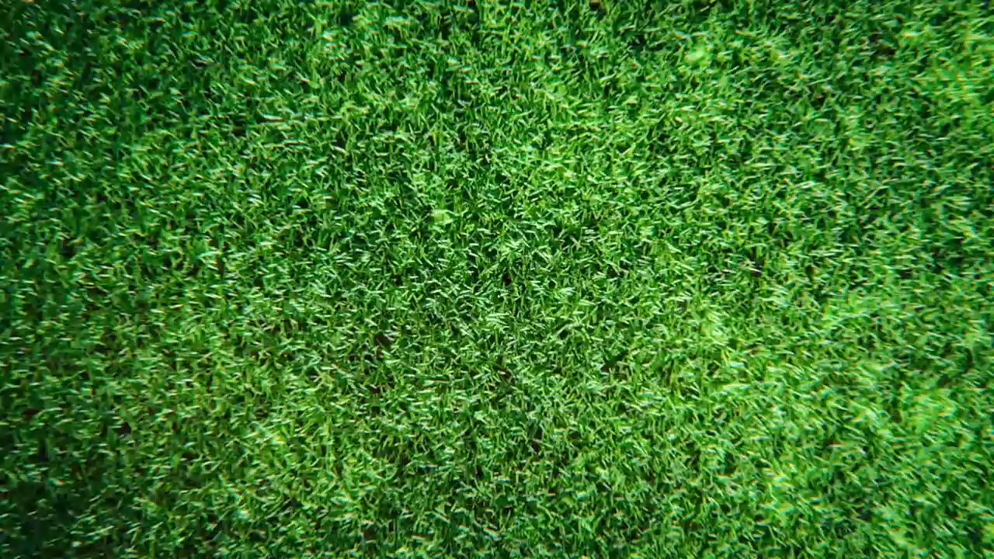


Slide 2
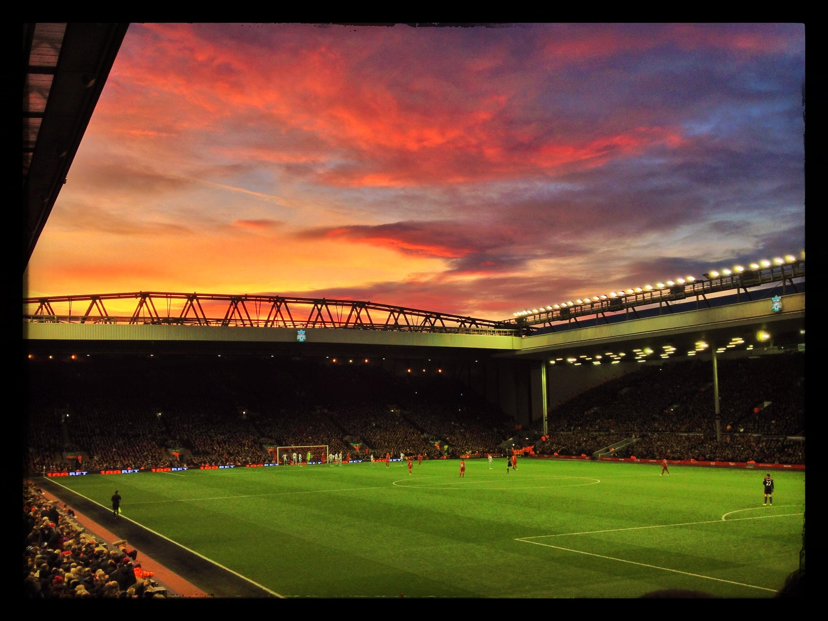


FOOTBALL
MULTIMEDIA TOOLS AND APPLICATIONS (25IT343E)

Slide 3
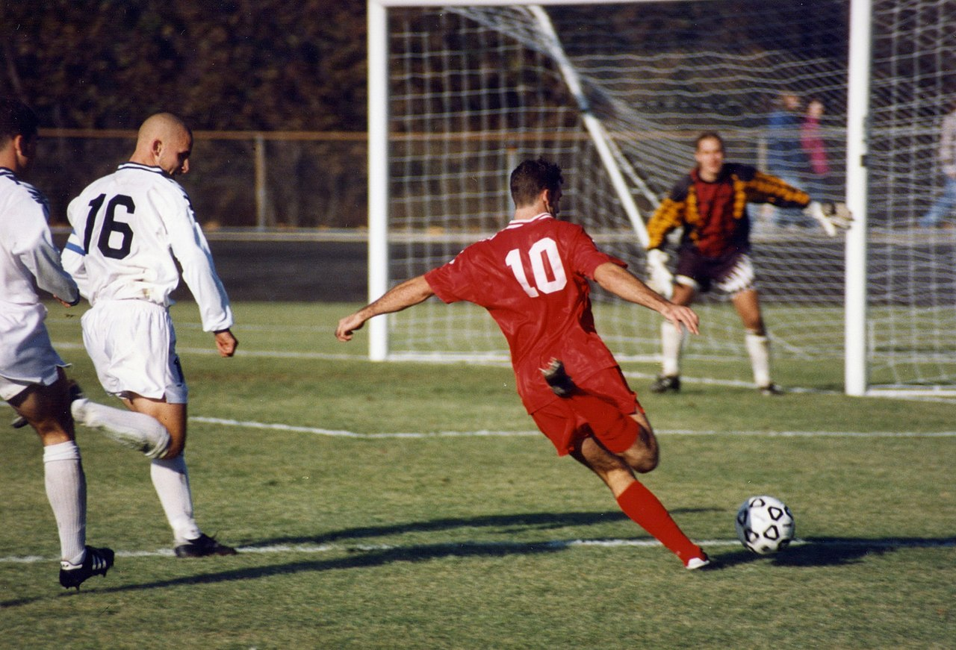
Association football, more commonly known as football or soccer, is a team sport played with a spherical ball between two teams of 11 players. It is played by approximately 250 million players in over 200 countries and dependencies, making it the world's most popular sport.

Slide 4

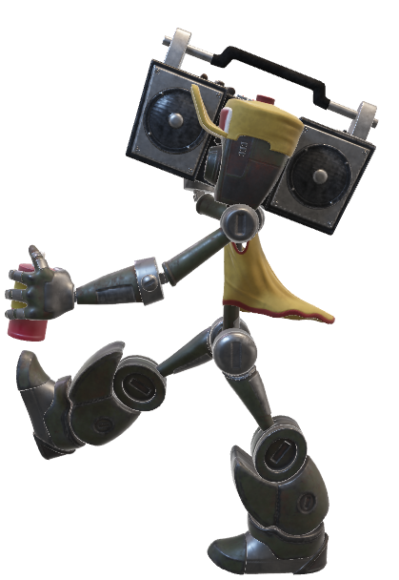

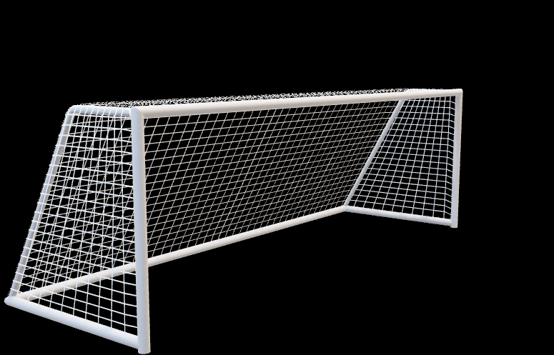
The game is played on a rectangular field called a pitch with a goal at each end. The objective of the game is to score by moving the ball beyond the goal line into the opposing goal.

Slide 5
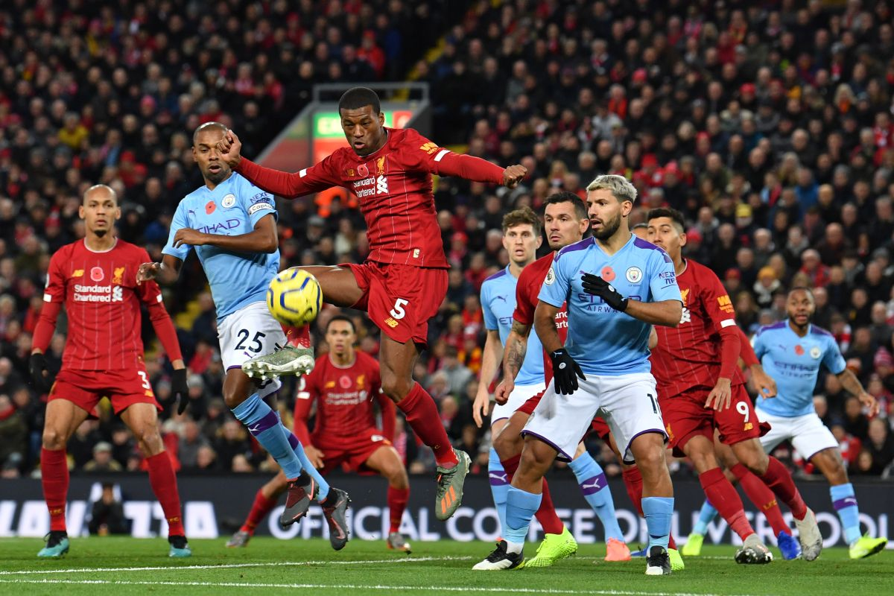
Players are not allowed to touch the ball with hands or arms while it is in play, except for the goalkeepers within the penalty area. Other players mainly use their feet to strike or pass the ball, but may also use any other part of their body except the hands and the arms. The team that scores most goals by the end of the match wins. If the score is level at the end of the game, either a draw is declared or the game goes into extra time or a penalty shootout depending on the format of the competition.

Slide 6


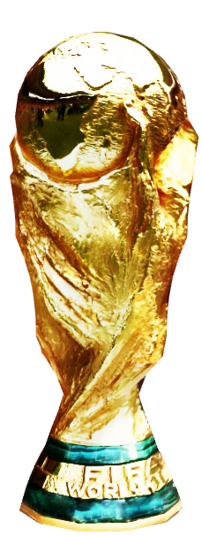
Football is governed internationally by the International Federation of Association Football (FIFA), which organises World Cups for both men and women every four years. The FIFA World Cup has taken place every four years. Approximately 190–200 national teams compete in qualifying tournaments within the scope of continental confederations for a place in the finals. The finals tournament, which is held every four years, involves 32 national teams competing over a four-week period.[b] It is the most prestigious football tournament in the world as well as the most widely viewed and followed sporting event in the world, exceeding the Olympic Games.

Slide 7
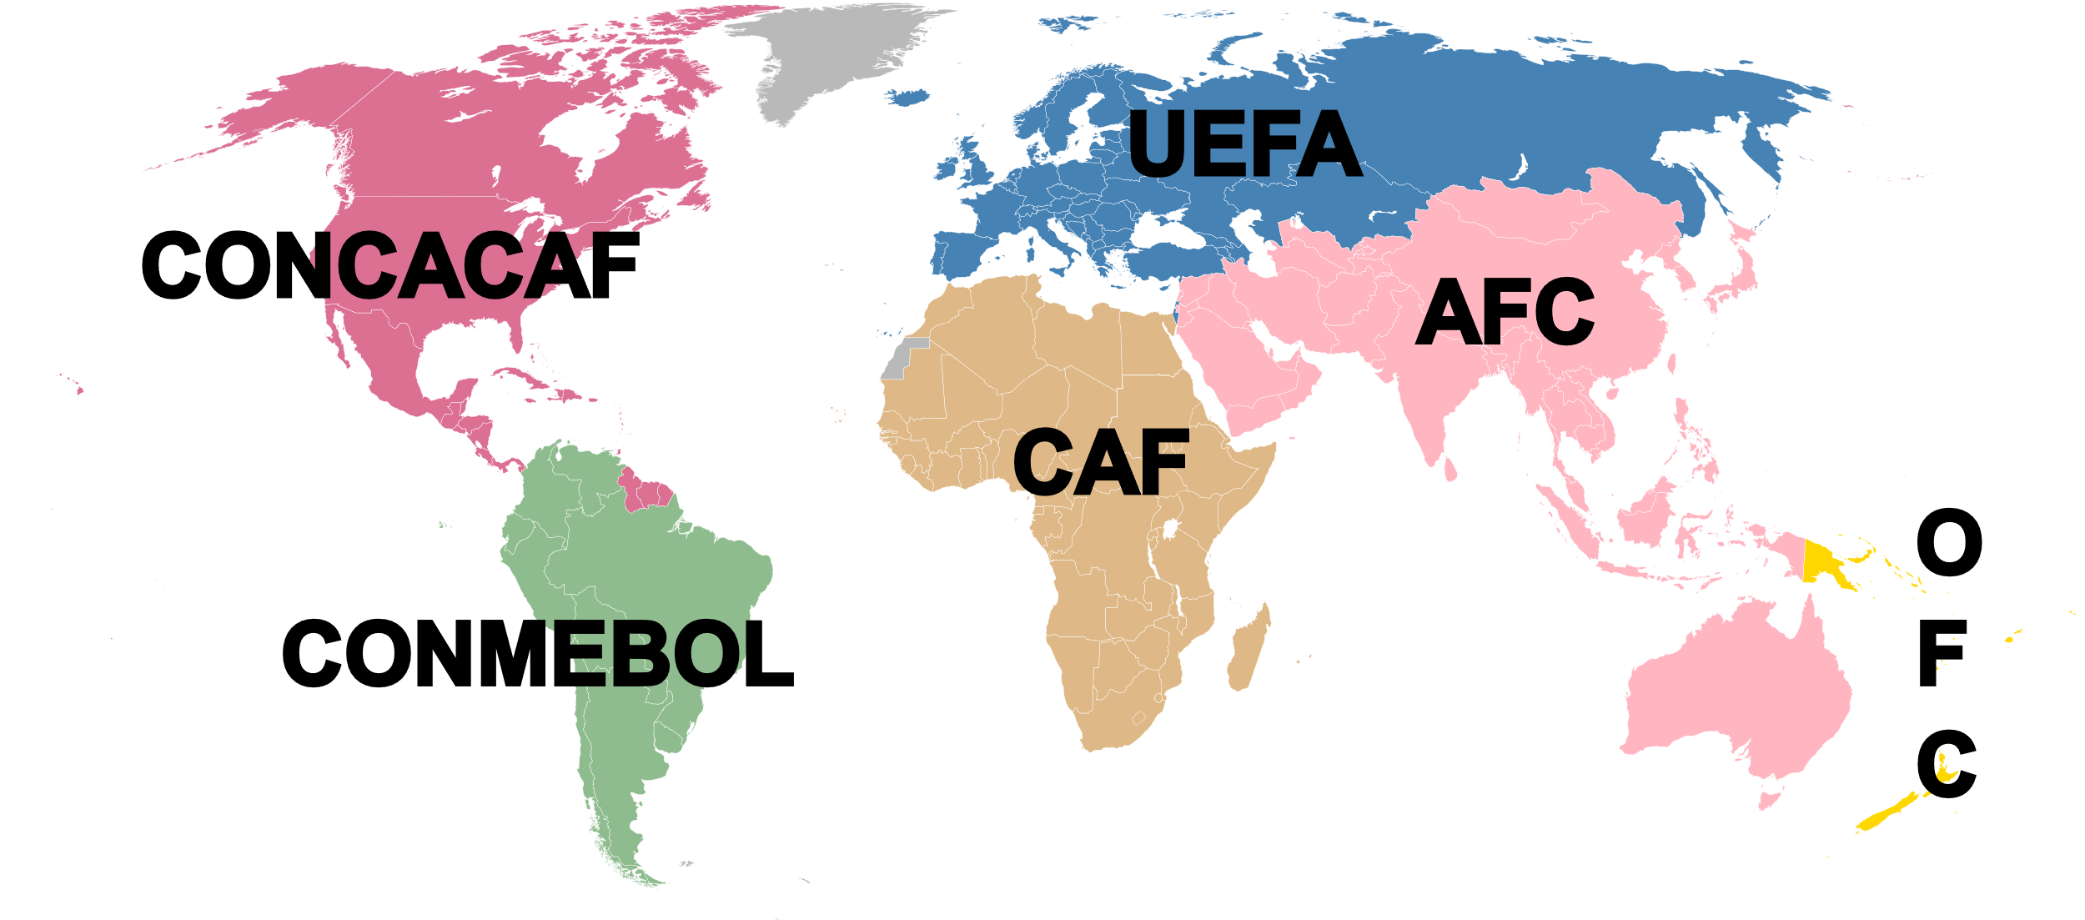
FIFA MEMBER ASSOCIATIONS
FIFA
UEFA
CONMEBOL
CAF
CONCAF
AFC
OFC

Slide 8
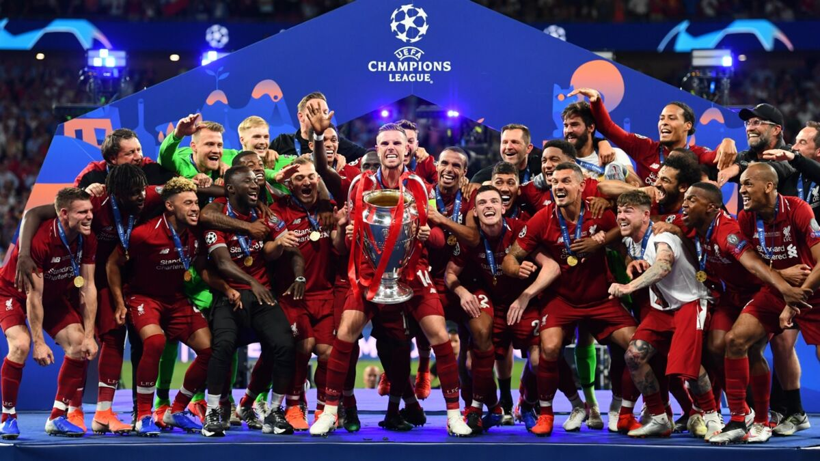
The most prestigious competition in club football is the UEFA Champions League which attracts an extensive television audience throughout the world. The final of the tournament has been, in recent years, the most-watched annual sporting event in the world.

Slide 9
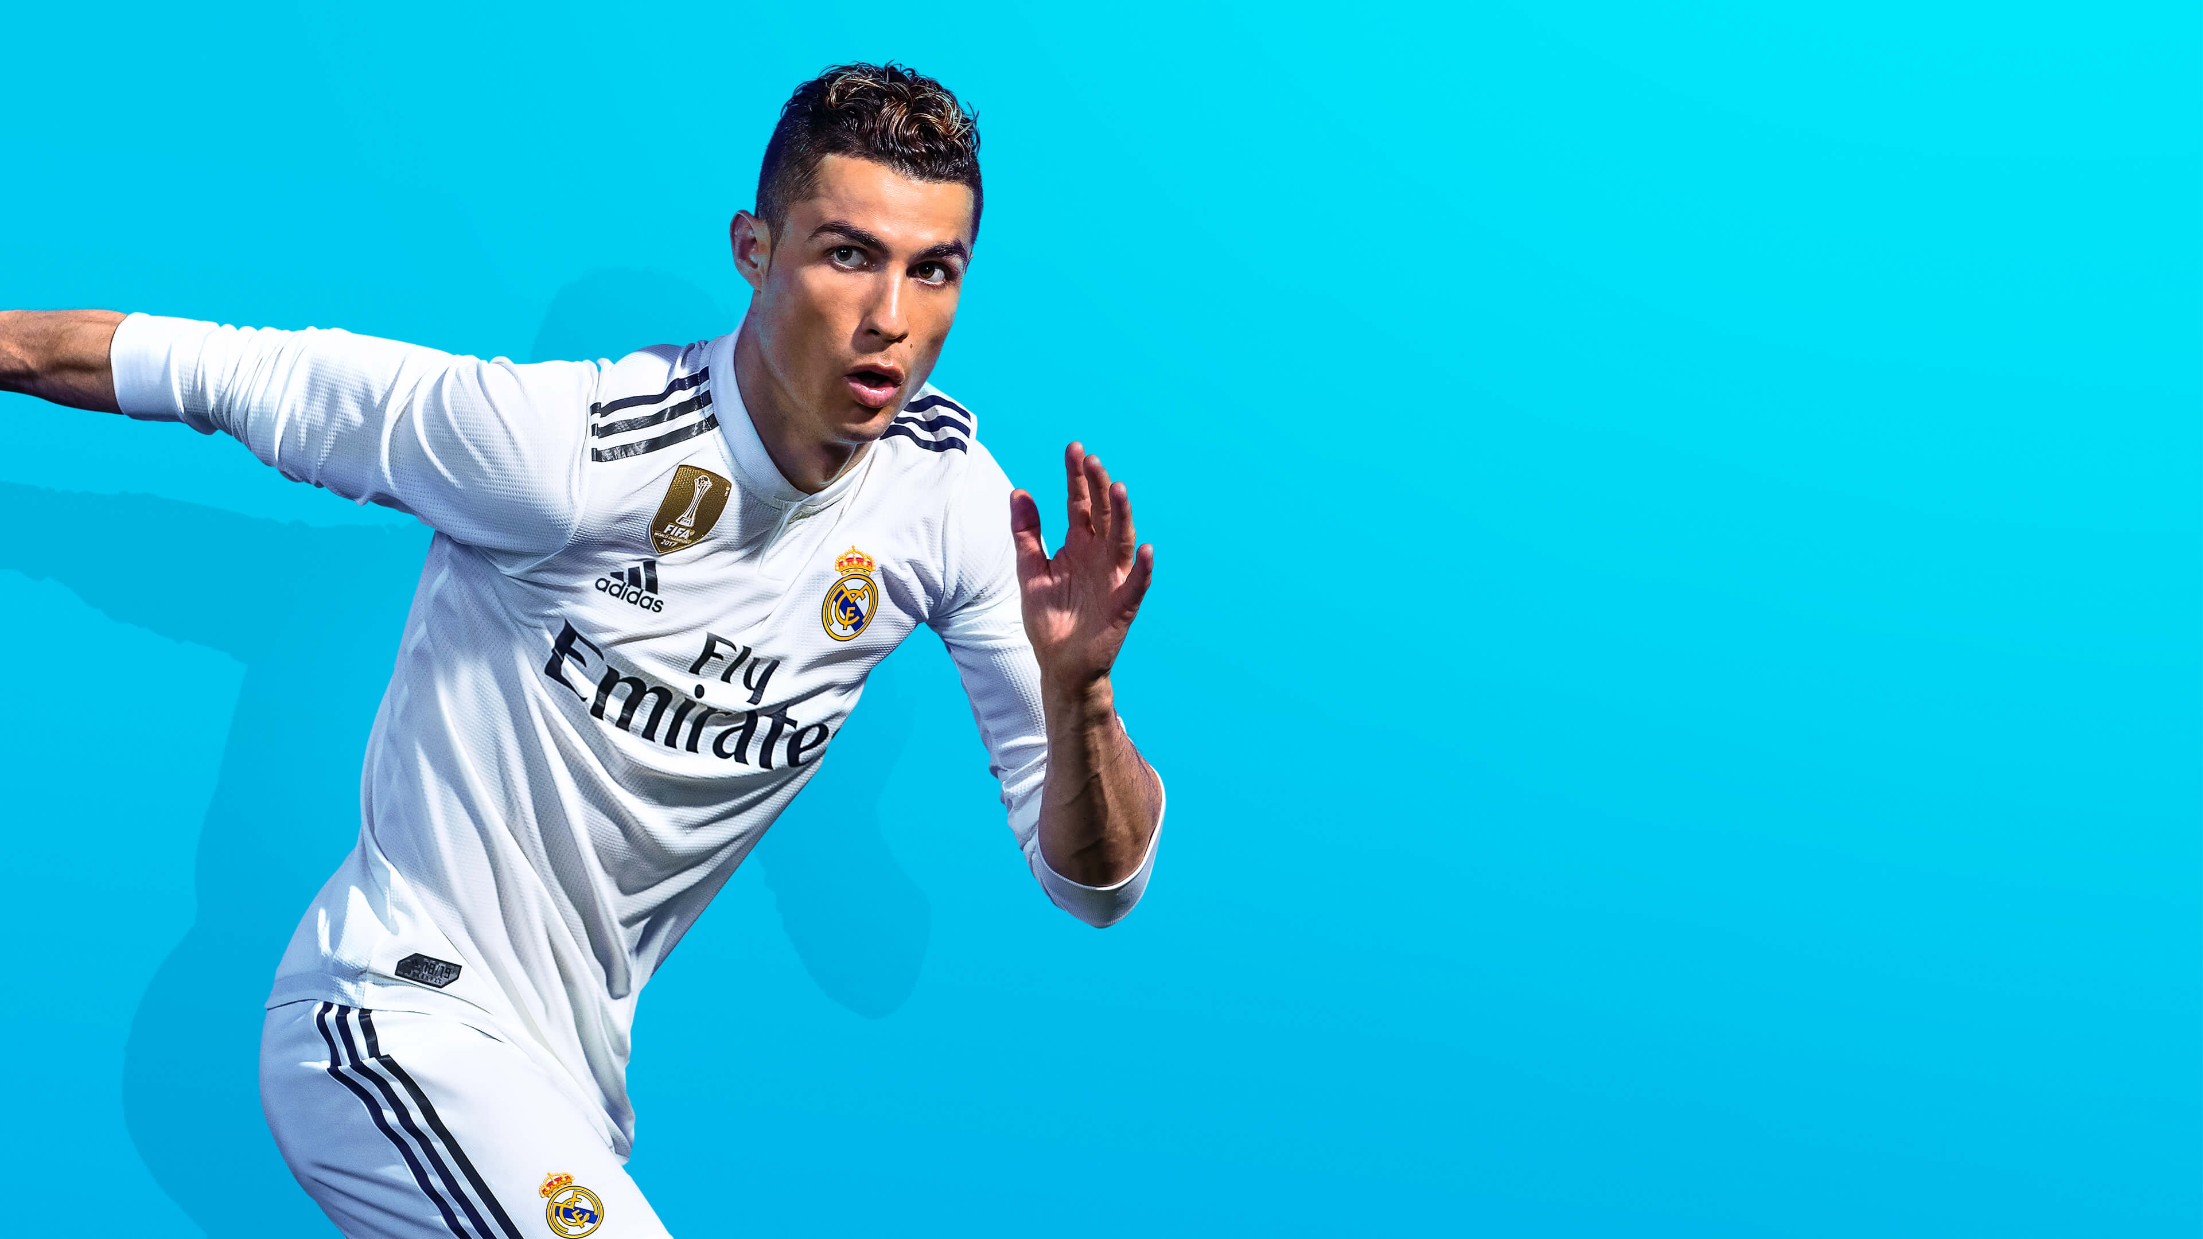





EUROPE’S TOP 5 LEAGUES

Slide 10
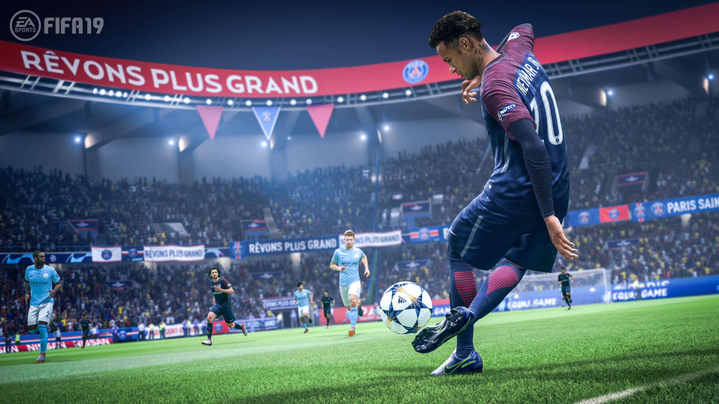
Thank You
OUSNIK POLLEY
RA1711003011018
D2-TP602

